Slide 1
Postmodernism and Irony: A Contemporary Cultural History
Mr. Beckett
2019

Slide 2
40 years of Father Knows Best

Slide 3
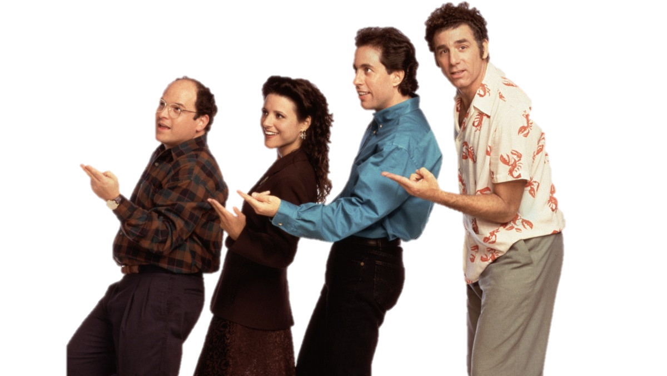
The Ironic ‘90s
By the 1990s mainstream, primetime TV was ripe for irony and cynicism.
The Simpson (all supremely flawed characters)
Seinfeld: a show about nothing, with “no hugging, no learning”
“Father is a buffoon”

Slide 4
Postmodernism
PoMo traits
Self referentiality
Moral relativism
Cynicism
Irony
Irreverence
Intertextuality/Parody
PoMo statements
“It’s all socially constructed”
“There are no absolute truths"
“Nobody Understands this like I do”
“Only my perspective matters”
“But also nothing matters”

Slide 5
Postmodernism
PoMo traits
Self referentiality………… Winking at yourself or the audience
Moral relativism…………. morals, ethics, and values are relative, changeable, protean
Cynicism…………. Generalized distrust
Irony……….. getting exactly the opposite of what is expected
Irreverence……. lack of respect
Intertextuality/Parody……………..think Family Guy references to other stories

Slide 6
Weekend at Burnsie’s
Self referentiality

Slide 7
Weekend at Burnsie’s
Moral Relativism

Slide 8
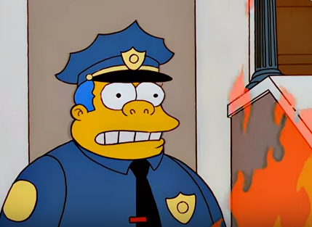
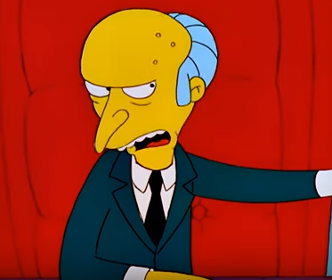
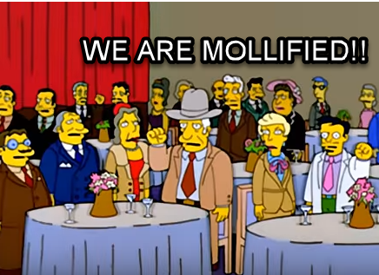
Weekend at Burnsie’s
Cynicism

Slide 9
Weekend at Burnsie’s
Irony

Slide 10
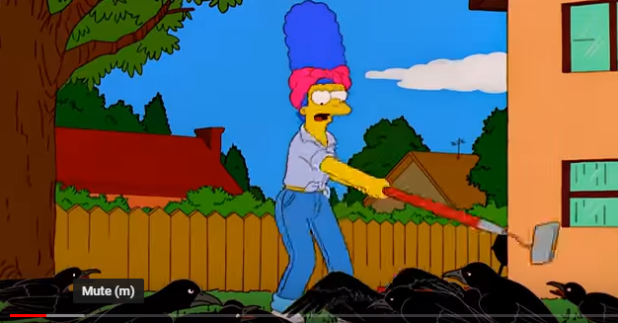
Weekend at Burnsie’s
Irreverence

Slide 11
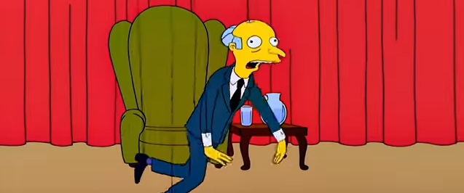
Weekend at Burnsie’s
Intertextuality/Parody

Slide 12
“Since to be really human […] is probably to be unavoidably sentimental and naïve and goo prone and generally pathetic” - David Foster Wallace

Slide 13
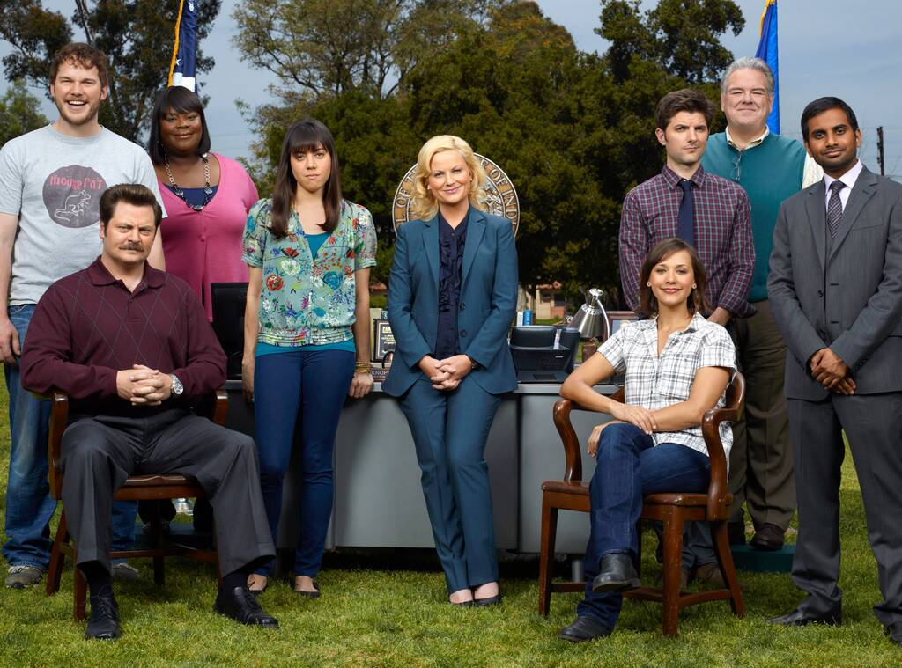
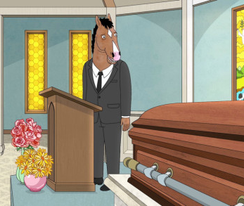
New Sincerity on TV

Slide 14
Post-Modern Cynicism vs New Sincerity
Sincerity | Irony
“goo prone” | caustic
naive | smart
open honest | closed off
uncool | hip
Offers wisdom | Offers no solutions…corrosive to the soul?

