Slide 2
Life of Pi Magic Realism 3
Beckett 2020

Slide 3
Authorial reticence
the lack of clear opinions about the accuracy of events and the credibility of the world views expressed by the characters in the text.

Slide 4
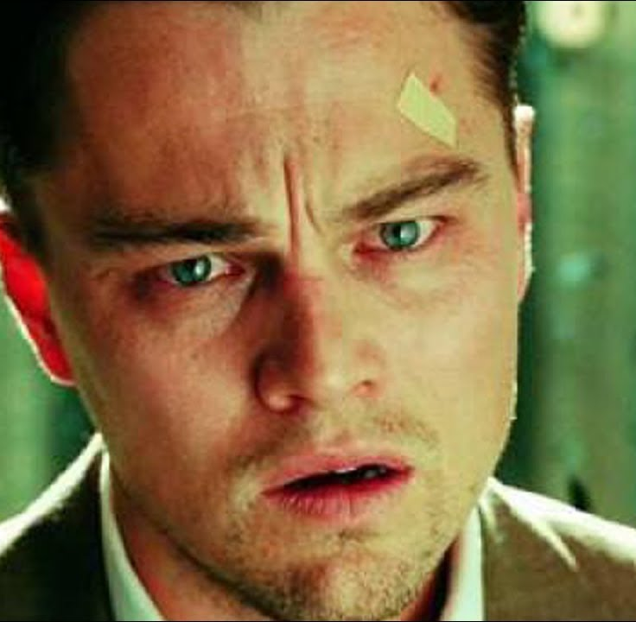
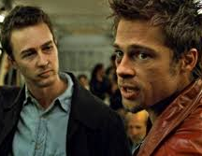
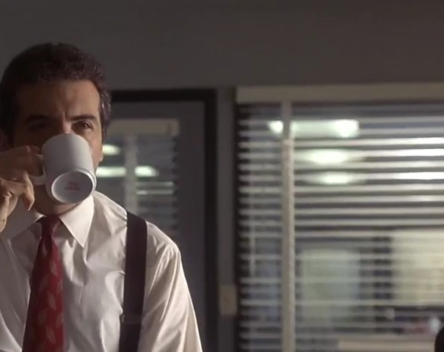
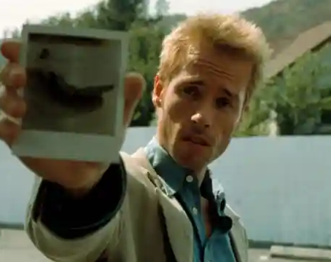
Can we trust the narrator?
Some great films from the from ’95-2010
In each case a twist or reveal makes the viewer completely change their opinion about the film
Its almost as if one has to view the film twice—once with fresh credulous eyes and once more with awoken skepticism.

Slide 5
In magic realist texts
“The narrator does not provide explanations about the credibility of events described in the text. Further, the narrator is indifferent; the story proceeds with ‘logical precision’ as if nothing extraordinary took place.”
Beloved the ghost of a beloved child returns in the flesh
The Brief Wonderous Life of Oscar Wao a young Dominican-American man grapples with loneliness and an ancient curse upon his family

Slide 6
Pi : Can we trust him as a narrator?
Martel the narrator is both amazed and skeptical of Mamaji’s claim
Then the elderly man said, “I have a story that will make you believe in God.”
I stopped waving my hand. But I was suspicious. Was this a Jehovah’s witness knocking at my door? “Does your story take place two thousand years ago in a remote corner of the Roman Empire?” I asked. (XII)

Slide 7
Can we Trust Pi? 2
The Japanese transport officials…
He tells an entirely different, short, and brutal tale.
It is in almost every respect more believable than the longer story with Richard Parker.
But Pi has one final question

Slide 8
Pi’s Final Question
"You're welcome. But before you go, I'd like to ask you something."
"Yes?"
"The Tsimtsum sank on July 2nd, 1977."
"Yes."
"And I arrived on the coast of Mexico, the sole human survivor of the Tsimtsum, on February 14th, 1978."
"That's right."
"I told you two stories that account for the 227 days in between."
"Yes, you did."
"Neither explains the sinking of the Tsimtsum."
"That's right."

Slide 9
"Neither explains the sinking of the Tsimtsum."
"That's right."
"Neither makes a factual difference to you."
"That's true."
"You can't prove which story is true and which is not. You must take my word for it."
"I guess so."
"In both stories the ship sinks, my entire family dies, and I suffer."
"Yes, that's true."
"So tell me, since it makes no factual difference to you and you can't prove the question either way, which story do you prefer? Which is the better story, the story with animals or the story without animals?"
Mr. Okamoto: "That's an interesting question..."

Slide 10
Mr. Chiba: "The story with animals."
Mr. Okamoto: "Yes. The story with animals is the better story.“
Pi Patel: "Thank you. And so it goes with God."
[Silence]
Mr. Chiba: "What did he just say?"
Mr. Okamoto: "I don't know."
Mr. Chiba: "Oh look-he's crying."
[Long silence]
Mr. Okamoto: "We'll be careful when we drive away. We don't want to run into Richard Parker."
Pi Patel: "Don't worry, you won't. He's hiding somewhere you'll never find him."

Slide 11
Do we trust Yann Martel ?
Does Life of Pi reduce religion to a fairy tale that makes us feel nice?
Does Life of Pi elevate storytelling almost to holy status?
Is Martel a bit too clever and cute in this novel?

Slide 12
The stories we tell ourselves to endure
Clearly, Pi preferred the better story, a massive extrapolation of positive thought, that leads him to make sense of things, that carries him to a new life with a loving wife and family. The other story, where humans are reduced to primal terror, could lead only to a brutally shattered life. In this story, you could see the entire story as an abandonment by God; but at the same time, it becomes evident that God was actually present at every moment. And in the end, he realizes that Richard Parker is actually his savior.
https://www.psychologytoday.com/ca/blog/the-tao-innovation/201211/meaning-faith-and-the-life-pi

