Slide 1
How to Rock With Photo Story
How to make your pictures come
to life with music and motion
Mr Beckett / Mr. Linseman
October 2009

Slide 2
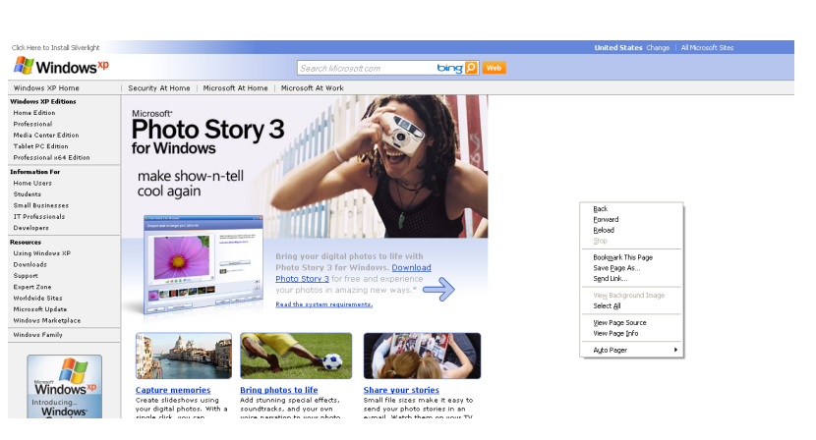
What is Photo Story 3?
Microsoft Photo Story 3 is a free application that allows users to create a show and tell presentation from their digital photos.

Slide 3
What can Photo Story 3 Do?
Photo Story 3 takes your digital photos and makes them into a presentation.
The software uses the “Ken Burns Effect” on digital photos. This means it zooms and pans over photos giving them an interesting visual effect

Slide 4
What can Photo Story 3 Do?
You can also add
narration,
effects,
transitions
background music
The end product is a Windows Media Video movie file with pan and zoom effects.

Slide 5
Why use Photo story 3?
It is a good way to “jazz up” still photos and it is almost always more interesting than a PowerPoint slideshow

