Slide 2
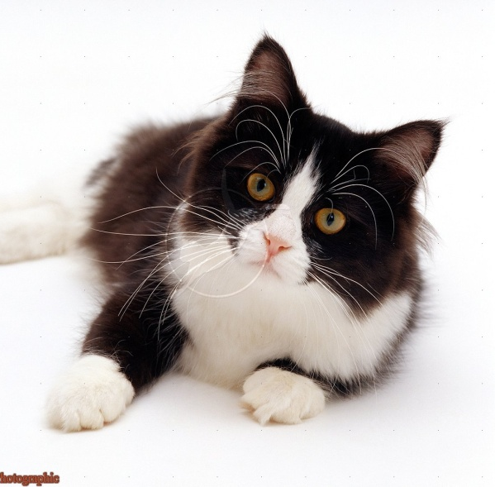
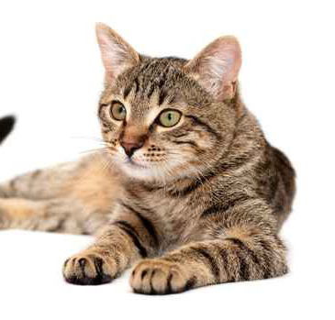
E
C
A
H
I
J
S
R
T
O
U
F
C
A
T
Notes:
Easy example

Slide 3
s
w
a

